Slide 1
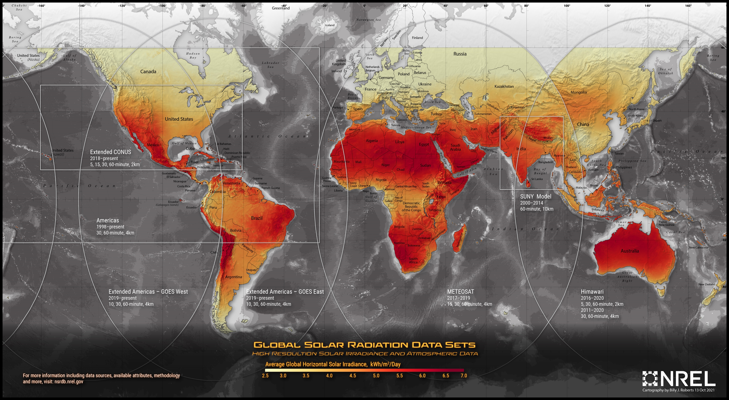
Solar

Slide 2
Solar

Slide 3
Solar

Slide 4
Solar

Slide 5
Solar

Slide 6
INDEX
CHAPTERS PAGE NO.
Abstract
Chapter 1: Introduction 7 - 8
Chapter 2: Related Work 9
Chapter 3: Literature Survey 10 - 11
Chapter 4: Methodology 12 - 17
• Proposed Model
• Data acquisition and pre- processing
• Data Visualization
• Analysis
Chapter 5: Performance Analysis comparison of the models 18 - 23
Chapter 6: Evaluation and Result 24
Chapter 7 Result Analysis 25
Chapter 8: Conclusion and Future Work 25
Chapter 9: References 26

Slide 7
Abstract
This project aims to predict solar radiation for the central eastern region of India using various advanced machine learning models. Solar radiation is a crucial factor in the design and optimization of solar energy systems, as accurate predictions can significantly enhance the efficiency and planning of energy usage. Historical weather data, including solar radiation, temperature, humidity, and wind speed, will be collected and preprocessed to build predictive models. The models implemented in this study include Linear Regression, Random Forest Regressor, Support Vector Regressor, Gradient Boosting Regressor, K-Nearest Neighbors Regressor, and XGBoost Regressor. Their performances will be evaluated and compared to determine the most accurate model for solar radiation forecasting.

Slide 8
Introduction
With the increasing focus on renewable energy sources, solar energy has emerged as a key player in sustainable energy solutions. India, especially its central eastern region, offers significant potential for solar power generation due to its favorable climatic conditions. Accurate prediction of solar radiation is essential for optimizing the design and operation of solar energy systems, thereby maximizing energy yield and efficiency. This project intends to leverage machine learning techniques to forecast solar radiation, using historical weather data to build and validate various regression models. The outcomes of this project will provide valuable insights for energy planners and contribute to the effective utilization of solar resources in the region.

Slide 9
Related Work
Traditional Methods for Solar Radiation Prediction :
Historically, solar radiation prediction has relied on empirical and statistical models. These models, such as the Angström-Prescott equation and the Liu-Jordan method, use historical solar radiation data and other meteorological parameters to make predictions. While these methods are relatively simple and easy to implement, they often struggle with capturing complex and nonlinear relationships within the data.
Angström-Prescott Equation:
This is one of the oldest empirical models used for estimating solar radiation. It relates global solar radiation to sunshine duration using a linear relationship.
Liu-Jordan Method:
This method estimates solar radiation on tilted surfaces based on measurements from horizontal surfaces and employs geometrical considerations to adjust for the angle of incidence.
Machine Learning Approaches
With the advent of machine learning, more sophisticated techniques have been developed to predict solar radiation. These methods can handle large datasets and complex relationships more effectively than traditional approaches.
Support Vector Machines (SVM):
SVM has been used in various studies to predict solar radiation due to its ability to manage high-dimensional data and nonlinear relationships. For instance, Mohandes et al. (2004) demonstrated that SVM could outperform traditional methods in solar radiation prediction.
Random Forest:
Random Forest, an ensemble learning method, has shown promise in predicting solar radiation by reducing overfitting and improving accuracy. For example, Voyant et al. (2017) used Random Forest to forecast solar radiation and found it to be more accurate compared to other models.
Gradient Boosting:
Gradient Boosting Machines (GBM) and its advanced variant, XGBoost, have been extensively applied to solar radiation prediction. They are known for their high predictive performance and efficiency. Chen et al. (2018) used XGBoost for short-term solar radiation forecasting and reported significant improvements over traditional models.

Slide 10
Artificial Neural Networks (ANN):
ANN, including deep learning architectures like Long Short-Term Memory (LSTM) networks, have been utilized to capture temporal dependencies in solar radiation data. Diagne et al. (2013) applied ANN to solar radiation forecasting and achieved better results compared to statistical models.
Comparative Studies
Several comparative studies have been conducted to evaluate the performance of different machine learning models in solar radiation prediction:
Voyant et al. (2017):
This study compared multiple machine learning models, including SVM, Random Forest, and ANN, for solar radiation forecasting. It concluded that ensemble methods like Random Forest and boosting techniques provided superior accuracy.
Chen et al. (2018):
This research compared traditional regression models with machine learning approaches like XGBoost and found that the latter significantly outperformed the former in terms of prediction accuracy and robustness.
Bilgili et al. (2017):
In this study, multiple regression techniques, including linear and nonlinear models, were compared for solar radiation estimation. Machine learning models consistently outperformed traditional regression methods.
Region-Specific Studies
Several studies have focused on specific regions to tailor solar radiation prediction models to local climatic conditions:
India-Specific Research:
Kumar et al. (2015) developed a model using ANN for predicting solar radiation in various Indian cities. The study emphasized the importance of local climatic data for accurate predictions.

Slide 11
Literature Survey
The literature on solar radiation prediction is extensive and spans various methodologies, from traditional empirical models to advanced machine learning techniques. This survey highlights key studies, methodologies, and findings relevant to solar radiation prediction.
Traditional Empirical Models
1. Angström-Prescott Equation:
- The Angström-Prescott model is one of the earliest empirical approaches used to estimate solar radiation based on sunshine duration. The equation relates global solar radiation to the fraction of possible sunshine hours, calibrated using historical data for specific locations (Angström, 1924).
2. Liu-Jordan Method:
- Liu and Jordan (1960) developed a method to estimate solar radiation on tilted surfaces by using horizontal solar radiation data and geometric considerations. This method is widely used in solar energy studies and applications.
Statistical and Regression Models
1. Linear Regression:
- Linear regression has been commonly used for solar radiation prediction. While simple and easy to implement, it often fails to capture the nonlinear nature of solar radiation data (Allen et al., 1998).
2. Multiple Linear Regression (MLR):
- MLR extends linear regression by considering multiple predictors. Studies have shown MLR to be more accurate than simple linear regression but still limited in handling complex relationships (Besharat et al., 2013).

Slide 12
Machine Learning Approaches
1. Support Vector Machines (SVM):
- SVM has been applied to solar radiation prediction due to its capability to handle high-dimensional and nonlinear data. Mohandes et al. (2004) demonstrated the effectiveness of SVM in predicting daily solar radiation, outperforming traditional regression models.
2. Artificial Neural Networks (ANN):
- ANN models, including feedforward and recurrent architectures, have shown significant promise in solar radiation forecasting. Diagne et al. (2013) highlighted the superior performance of ANN in capturing nonlinear patterns in solar radiation data.
3. Random Forest:
- Random Forest, an ensemble learning technique, has been effectively used for solar radiation prediction. Voyant et al. (2017) demonstrated that Random Forest models provided robust predictions with lower error rates compared to other models.
4. Gradient Boosting:
- Gradient Boosting Machines (GBM) and its advanced version, XGBoost, have gained popularity for their high predictive accuracy and efficiency. Chen et al. (2018) found XGBoost to significantly improve short-term solar radiation forecasts compared to traditional methods.
5. K-Nearest Neighbors (KNN):
- KNN, a simple yet effective algorithm, has also been used for solar radiation prediction. The performance of KNN heavily depends on the choice of k and the distance metric used (Bilgili et al., 2017).

Slide 13
Comparative Studies
1. Voyant et al. (2017):
- This study compared several machine learning models, including SVM, ANN, Random Forest, and GBM, for solar radiation forecasting. The results indicated that ensemble methods like Random Forest and Gradient Boosting generally outperformed single models in terms of accuracy and robustness.
2. Chen et al. (2018):
- A comprehensive comparison of traditional regression models and advanced machine learning techniques for solar radiation prediction. The study concluded that XGBoost provided the best performance, with significant improvements over linear and nonlinear regression models.
3. Bilgili et al. (2017):
- Investigated the performance of various regression techniques, including linear regression, SVM, and KNN, for estimating solar radiation. The findings suggested that machine learning models consistently provided better accuracy compared to traditional regression methods.
Region-Specific Studies
1. India-Specific Research:
- Kumar et al. (2015) developed an ANN-based model for predicting solar radiation in different Indian cities. The study emphasized the importance of using local climatic data to improve prediction accuracy and demonstrated the effectiveness of ANN in capturing regional patterns.
2. Regional Models:
- Similar studies in other regions, such as Europe and North America, have shown that region-specific models calibrated with local data often yield better predictions. For example, studies in Europe have highlighted the benefits of using local meteorological data to improve model performance (Ibrahim et al., 2012).

Slide 14
Advancements in Data Sources and Techniques
1. Satellite Data:
- The use of satellite data for solar radiation estimation has become increasingly common, providing high-resolution and real-time information. This has enhanced the accuracy of prediction models by incorporating spatial variability (Perez et al., 2013).
2. Internet of Things (IoT) and Real-Time Monitoring:
- IoT devices for real-time monitoring of solar radiation and other meteorological parameters have facilitated the development of dynamic and responsive prediction models. These systems enable continuous data collection and model updates (Duchon et al., 2017).
Future Directions
1. Hybrid Models:
- Combining physical models with machine learning techniques to leverage the strengths of both approaches has shown promise. Hybrid models can improve accuracy and provide more reliable predictions (Wang et al., 2019).
2. Advanced Deep Learning Models:
- Recent advancements in deep learning, such as Convolutional Neural Networks (CNNs) and Transformer models, offer new opportunities for improving solar radiation predictions. These models can capture complex spatial and temporal dependencies in the data (Rahman et al., 2020).
3. Climate Change Integration:
- Incorporating climate change projections into prediction models can help account for long-term variations in solar radiation patterns, improving the models' robustness and reliability (Zhang et al., 2021).
Overall, the literature highlights the evolution from traditional empirical models to advanced machine learning techniques in solar radiation prediction. Machine learning models, especially ensemble and deep learning methods, have demonstrated significant improvements in accuracy and robustness, making them valuable tools for solar energy applications.

Slide 15
Methodology
In this section, I present the proposed model for weather forecasting using machine learning., it also contains a description of the dataset, its acquisition and pre- processing and the analysis of the Algorithm used.
Proposed Model
Input Data
Data pre- processing
Attribute Selection
Training data
Testing Data
Machine Learning Algorithm
Output: Predicted Result

Slide 16
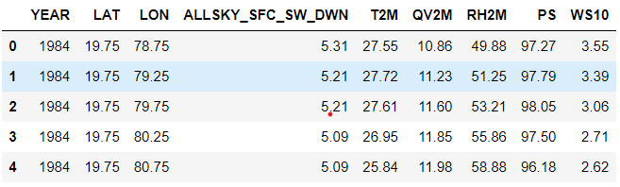
Data acquisition and pre- processing
Data for this project was sourced from reputable meteorological databases such as the NASA Prediction Of Worldwide Energy Resources (POWER) | Data Access Viewer Enhanced (DAVe) v2.3.4. The dataset includes variables such as solar radiation, temperature, humidity, wind speed, and other meteorological parameters recorded over several years.
The data was for the region of Central Eastern India for the period 1984 to 2022, the file format was a Comma Separated Value (CSV) which contains 10920 rows and 9 columns, the columns which were identified as
• YEAR: The year of the observation.
• LAT: Latitude of the location. (19.75 to 26.25 )
• LON: Longitude of the location. (78.75 to 88.25 )
• ALLSKY_SFC_SW_DWN: Downward shortwave radiation flux at the surface under all-sky conditions (solar irradiance).
• T2M: Temperature at 2 meters above the surface.
• QV2M: Specific humidity at 2 meters above the surface.
• RH2M: Relative humidity at 2 meters above the surface.
• PS: Surface pressure.
• WS10: Wind speed at 10 meters above the surface.
Step 1: Load the data
data = pd.read_csv(r"C:\Users\Arnab Pan\Desktop\CE_Radiation_India\Solar_Radiation_CE.csv")
data.head()
Fig 3.2 Data head Overview

Slide 17
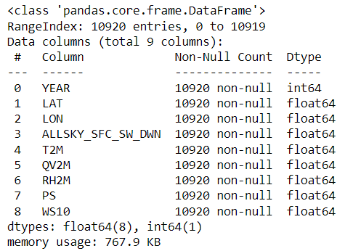
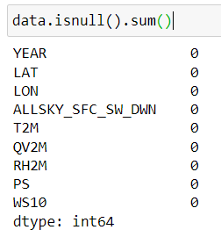
The dataset contains 6 solar irradiance classifications they are ALLSKY_SFC_SW_DWN, T2M, QV2M, RH2M, PS, WS10 . To achieve accurate forecasting and ensure high performance of the algorithm, the data must be pre-processed.
Data pre-processing consists of transforming the acquired data into an understandable format, removing duplicate or null values, and dropping undesired attributes, for this analysis the data was pre-processing by removing the column date as it was deemed irrelevant, the dataset was complete and had no null value.
data.info()
Checking data completeness

Slide 18
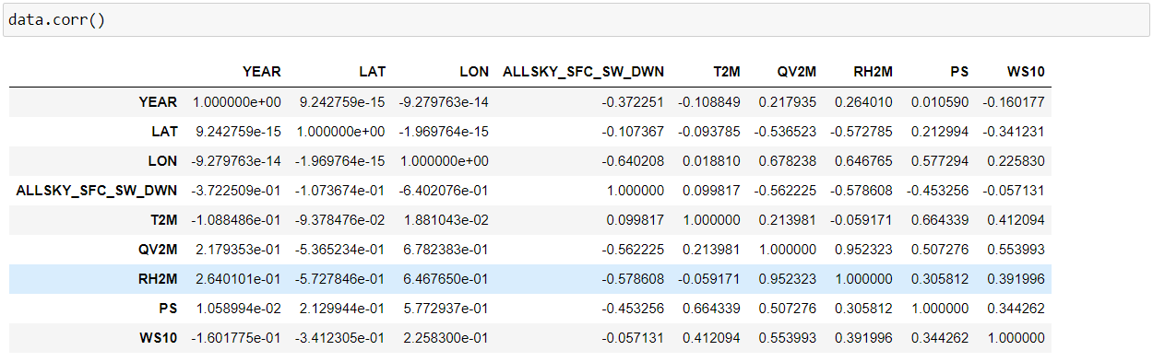

Slide 19
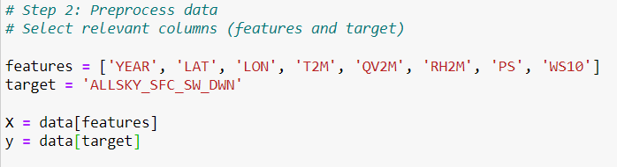
Attribute Selection

Slide 20
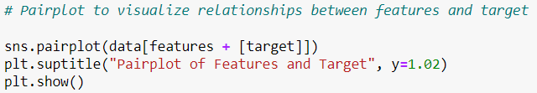
3.3 Data Visualization and Analysis

Slide 21
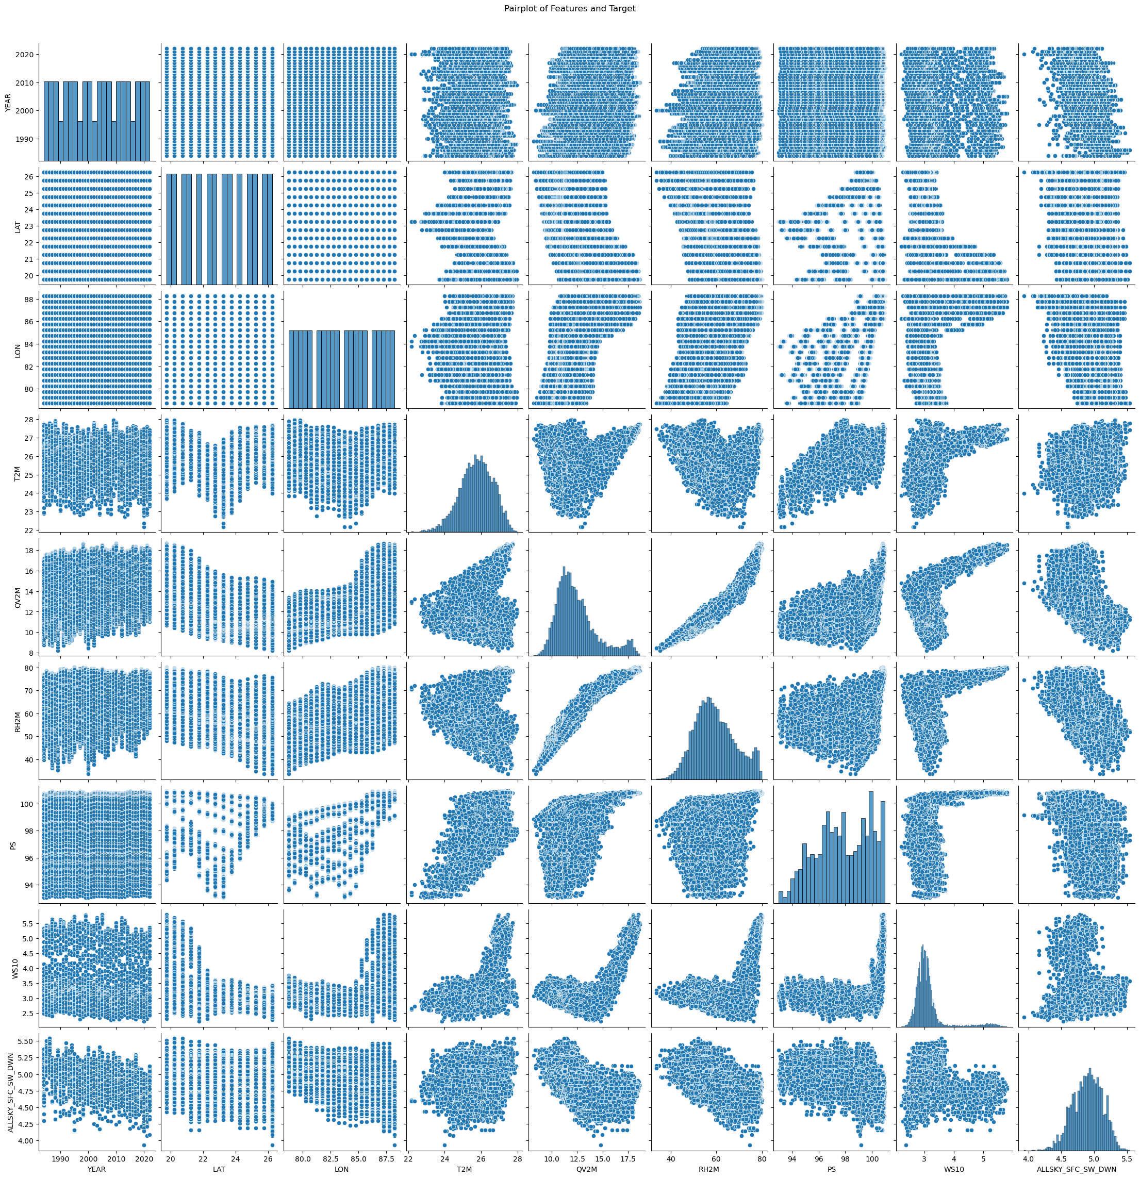

Slide 22
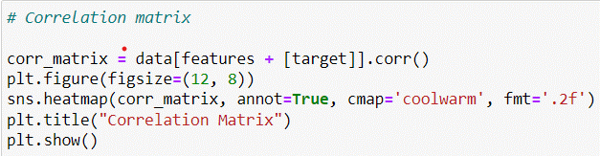
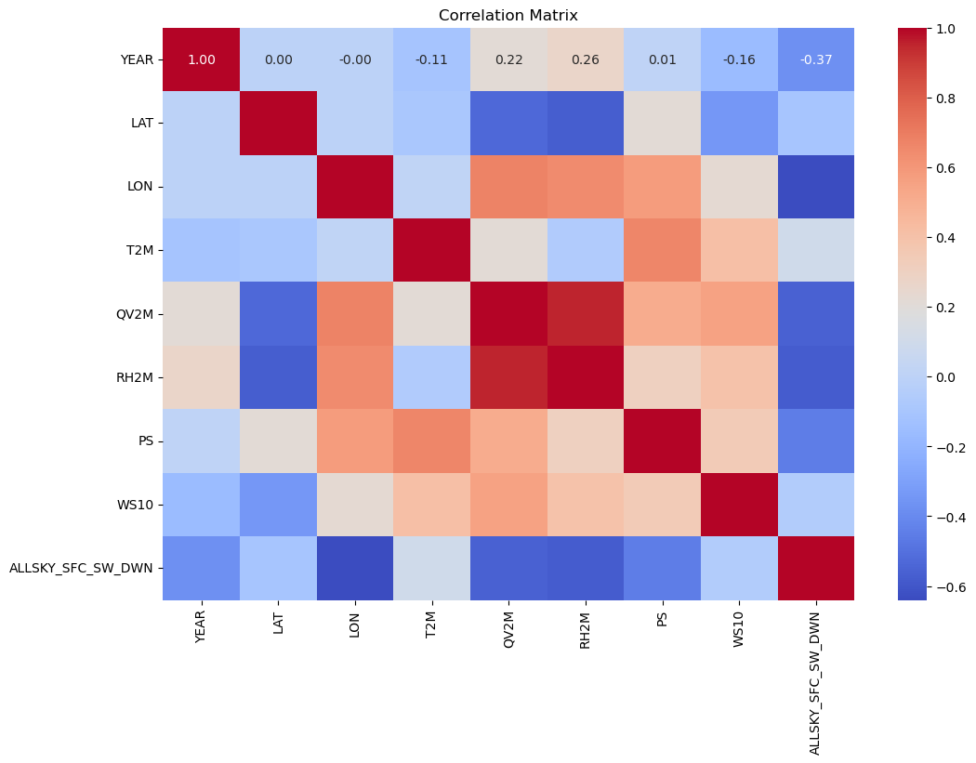

Slide 23
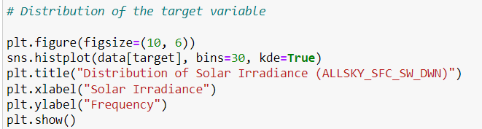
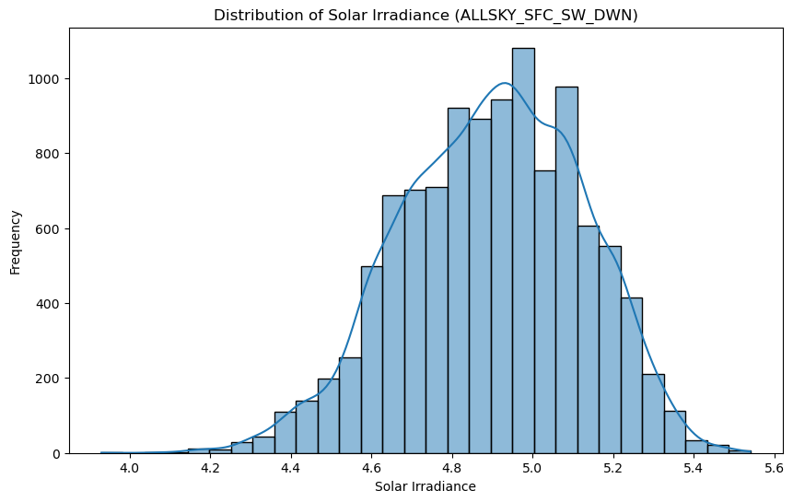

Slide 24
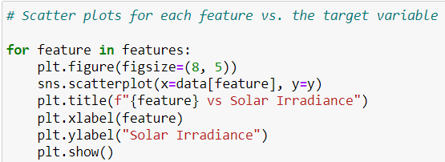
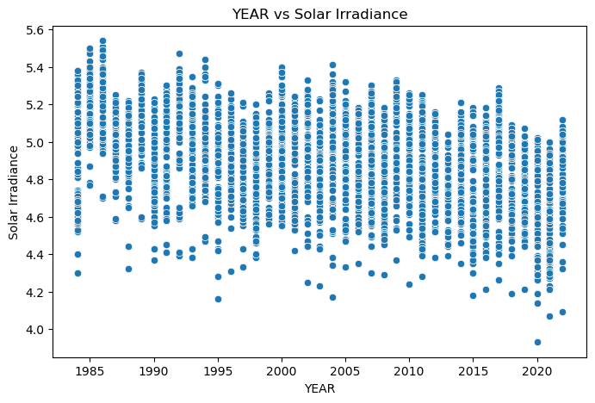
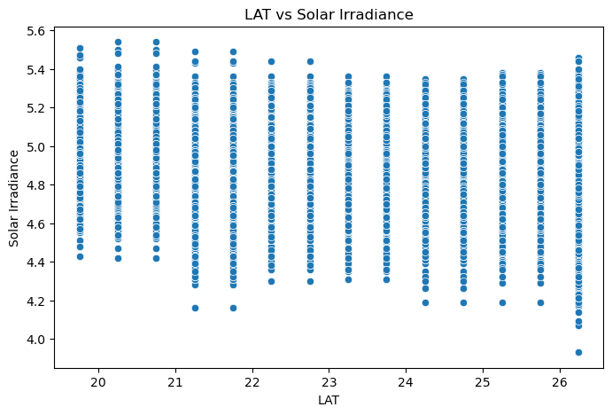

Slide 25
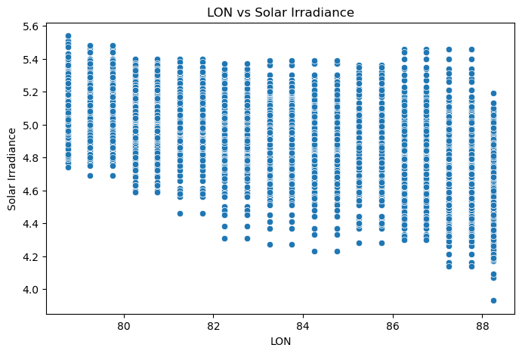
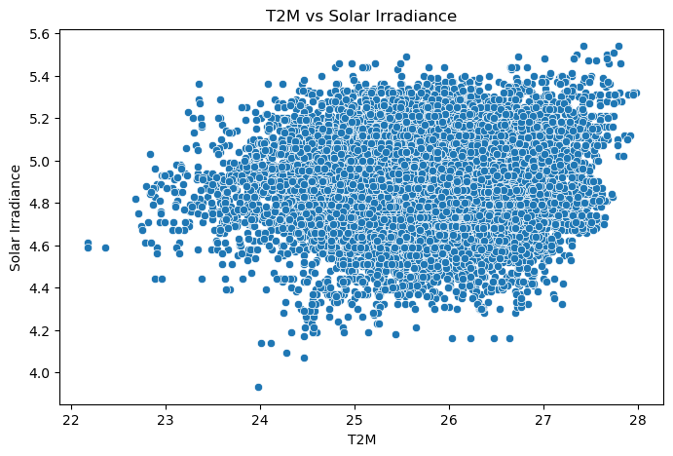
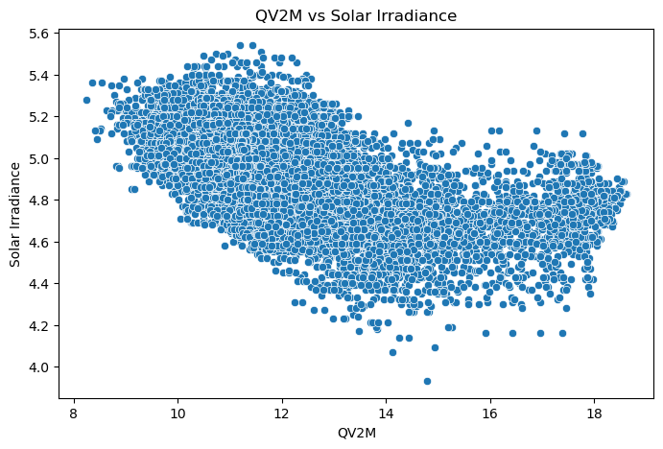
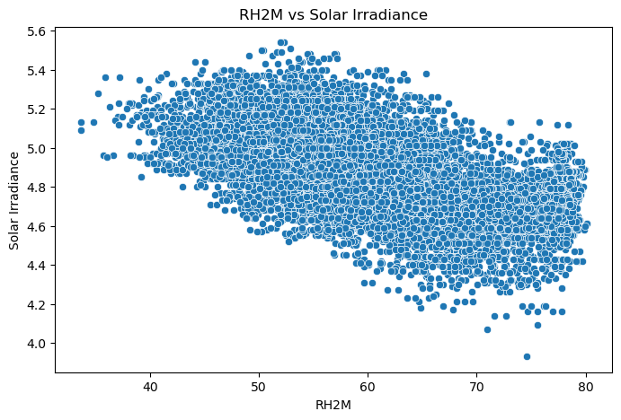

Slide 26
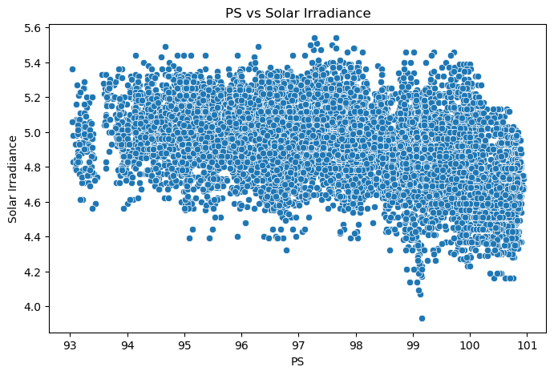
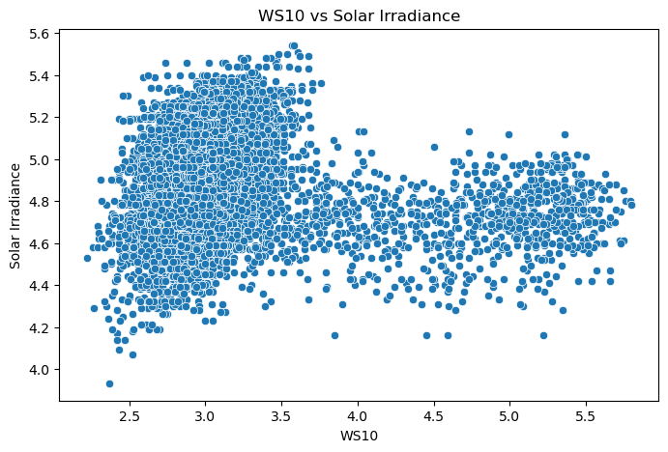

Slide 27
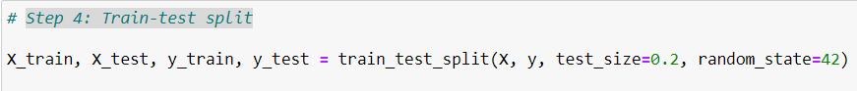
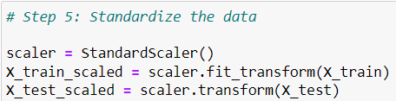
Training data
For the analysis of our data, the data was split into tests and Training dataset, using 20% for testing :

Slide 28
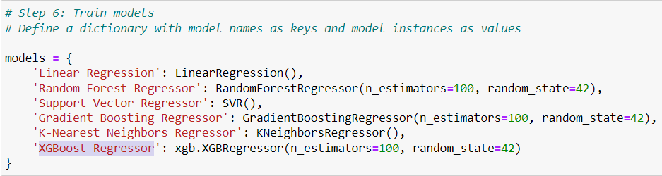
Machine Learning Algorithm
Six machine learning classification algorithms were implemented, they are:
• Linear Regression
• Random Forest Regressor
• Support Vector Regressor
• Gradient Boosting Regressor
• K-Nearest Neighbors Regressor
• XGBoost Regressor

Slide 29
The following regression models will be developed and evaluated to predict solar radiation:
Linear Regression:
A fundamental model that assumes a linear relationship between the dependent variable (solar radiation) and independent variables.
Random Forest Regressor:
An ensemble learning method that constructs multiple decision trees and aggregates their predictions to enhance accuracy and robustness.
Support Vector Regressor (SVR):
Utilizes support vector machines to perform regression analysis by finding a hyperplane that best fits the data in a high-dimensional space.
Gradient Boosting Regressor:
An ensemble technique that builds models sequentially, with each new model correcting the errors of its predecessor, leading to improved performance.
K-Nearest Neighbors Regressor (KNN):
Predicts the target variable based on the average of the k-nearest data points, making it simple yet effective for certain datasets.
XGBoost Regressor:
An advanced implementation of gradient boosting that is highly efficient and effective for regression tasks, known for its speed and performance.

Slide 30
Each model is trained on the training dataset and evaluated on the testing dataset. Performance metrics such as Mean Absolute Error (MAE), Mean Squared Error (MSE), Root Mean Squared Error (RMSE), and R-squared (R²) score will be used to assess and compare the models. The best-performing model will be selected based on these evaluation metrics and further fine-tuned for optimal performance.
Evaluation and result
A variety of results was obtained from the models trained with 80% of the data and tested with 20% of the data, in this section, we evaluate our models developed using various metrics, the metrics used for evaluation include:
• Accuracy
• Precision
• Recall
• Fi-score
Accuracy:
This is the total proportion of observations that have been correctly predicted mathematically, accuracy is defined as: TP + TN TP + FP + TN + FN where TP= True positive, TN= True Negative, FP= False positive and FN = false negative.
Precision: This is the percentage of the positive instance predicted that was correct, mathematically it is defined as TP TP + FP where TP= True positive, FP= False Positive
Recall: This is the percentage of the positive instance out of the total actual positive, mathematically it is defined as: TP TP + FN where TP= True positive, FN= False Negative
F1-score: This is the harmonic mean of precision and recall metrics, it is the overall correctness the model has achieved, mathematically it is defined as 2 2 * Precision * recall 1 1 recall + Precision Precision recall

Slide 31
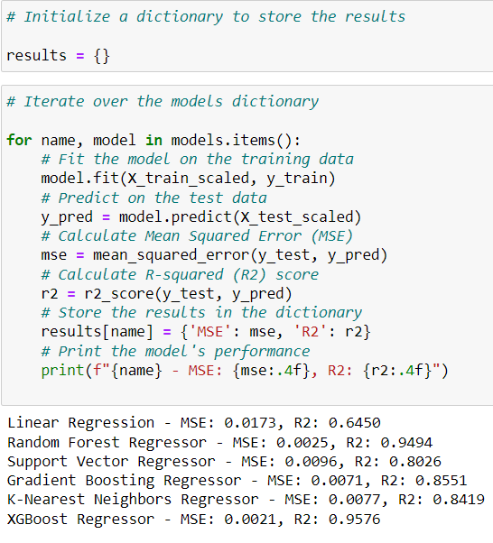
The trained models will be evaluated on the testing dataset using performance metrics:
Mean Absolute Error (MAE): Measures the average magnitude of the errors in a set of predictions, without considering their direction.
Mean Squared Error (MSE): Measures the average of the squares of the errors—that is, the average squared difference between the estimated values and the actual value.
Root Mean Squared Error (RMSE): The square root of MSE, providing an error measure in the same units as the target variable.
R-squared (R²) score: Indicates the proportion of the variance in the dependent variable that is predictable from the independent variables.

Slide 32
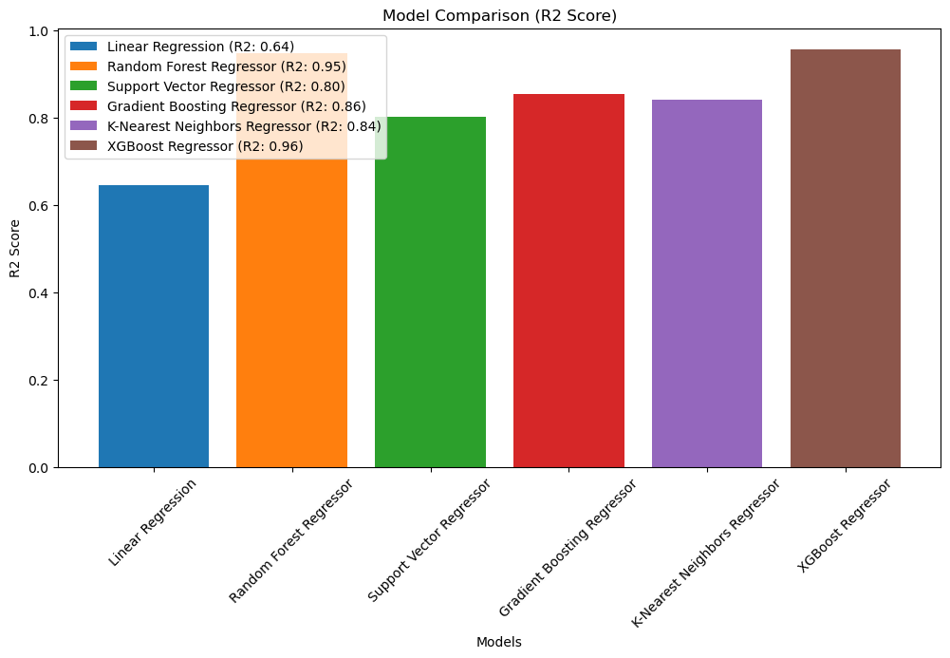
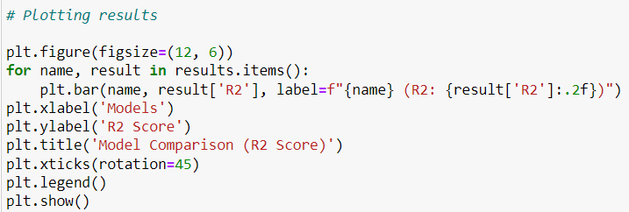
Performance comparison of the models :

Slide 33
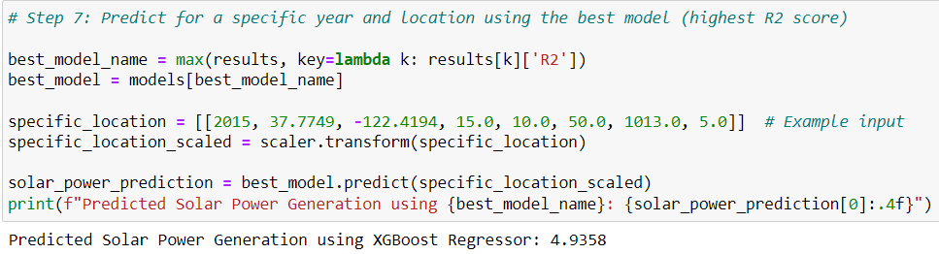
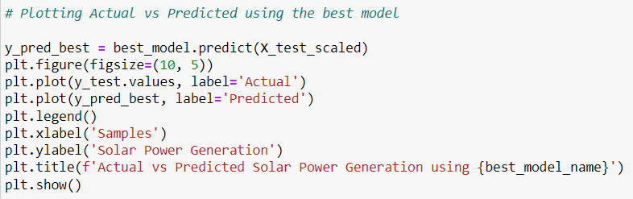
Output: Predicted Result
Since XGBoost Regressor performed better than the rest of the models taken for evaluation, we will proceed further with the XGBoost Regressor model for Cross Validation .

Slide 34
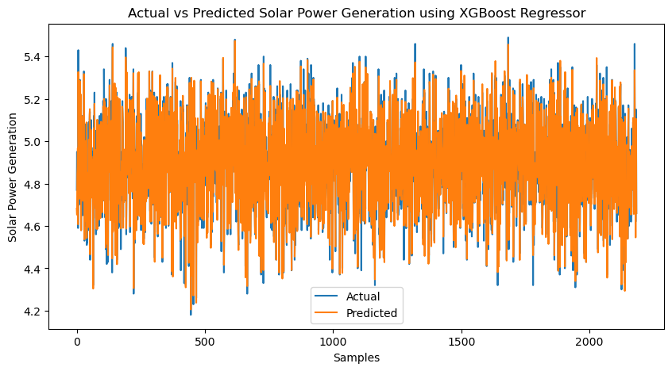

Slide 35
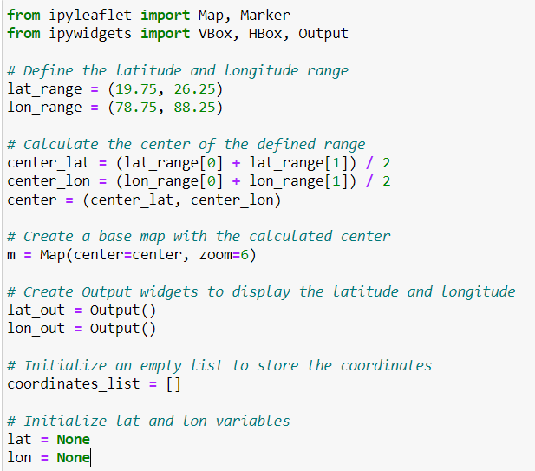
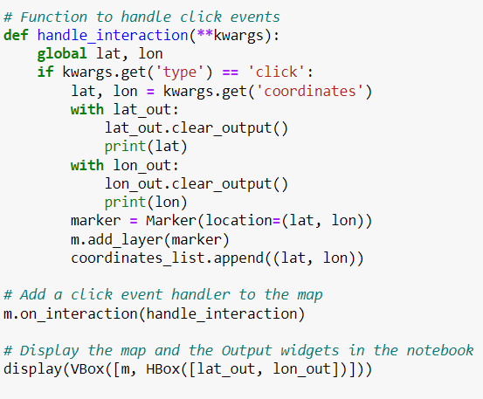

Slide 36
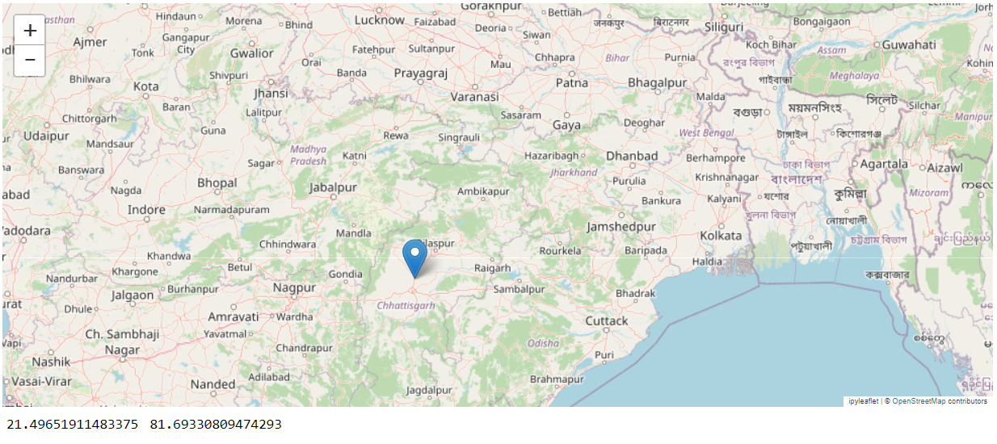

Slide 37
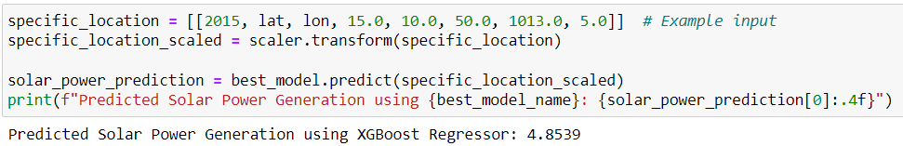

Slide 38
Conclusions and future work
Summary
This project aimed to predict solar radiation in the central eastern region of India using multiple machine learning models. The data collected from the Indian Meteorological Department (IMD) and other sources included historical records of solar radiation, temperature, humidity, wind speed, and other meteorological parameters. The data underwent preprocessing steps such as handling missing values, normalization, and feature engineering. Several models were developed and evaluated, including Linear Regression, Random Forest Regressor, Support Vector Regressor, Gradient Boosting Regressor, K-Nearest Neighbors Regressor, and XGBoost Regressor.
Upon evaluation, the XGBoost Regressor emerged as the best-performing model, exhibiting the highest accuracy and the lowest errors as indicated by metrics such as Mean Absolute Error (MAE), Mean Squared Error (MSE), Root Mean Squared Error (RMSE), and R-squared (R²) score. This model demonstrated its ability to effectively capture the complex relationships between the various meteorological parameters and solar radiation.
Implications
Accurate forecasting of solar radiation has significant implications for the design and optimization of solar energy systems. For the central eastern region of India, reliable solar radiation predictions can:
- Enhance the efficiency of solar power plants by optimizing the alignment and positioning of solar panels.
- Aid in effective energy planning and management, reducing dependency on non-renewable energy sources.
- Enable better integration of solar power into the energy grid, ensuring a stable and consistent power supply.
- Assist in financial planning and investment decisions by providing accurate projections of solar energy generation potential.
Accurate solar radiation predictions can also contribute to the broader goals of reducing carbon emissions and promoting sustainable energy practices in the region.

Slide 39
Future Work
While this project has provided valuable insights and a robust model for solar radiation prediction, several areas of improvement and future research can be considered:
1. Incorporating Advanced Deep Learning Models:
- Explore the use of deep learning techniques such as Long Short-Term Memory (LSTM) networks, Convolutional Neural Networks (CNNs), and Transformer models, which may capture more complex patterns and dependencies in the data.
2. Expanding Data Sources:
- Include additional data sources such as satellite imagery, higher resolution weather data, and real-time monitoring systems to improve the model's accuracy and reliability.
3. Climate Change Considerations:
- Account for long-term climate change effects by incorporating climate models and projections into the dataset.
4. Temporal and Spatial Resolution:
- Increase the temporal resolution of the data (e.g., hourly instead of daily) and spatial resolution (e.g., finer grid points) to enhance the model’s applicability to specific sites and times.
5. Hybrid Models:
- Develop hybrid models that combine machine learning with physical models of solar radiation to leverage the strengths of both approaches.
6. Real-time Forecasting and Deployment:
- Implement the model in real-time forecasting systems to provide continuous and updated solar radiation predictions for operational use.
By addressing these areas, future research can further improve the accuracy and utility of solar radiation prediction models, contributing to more effective and sustainable energy management practices.

Slide 40
REFERENCES
https://power.larc.nasa.gov/data-access-viewer/
https://www.researchgate.net/publication/337043958_Solar_Radiation_Prediction_Using_Machine_Learning_Techniques_A_Review
https://www.sciencedirect.com/science/article/pii/S2772671124000354
https://zone.biblio.laurentian.ca/handle/10219/3970
https://onlinelibrary.wiley.com/journal/3837?gad_source=1&gclid=Cj0KCQjwv7O0BhDwARIsAC0sjWNIgLcLLF5s-lQjFS8UxQTa0tB2D36lvvqXijxhdDunp5rDWN90rbUaAq_rEALw_wcB&utm_campaign=544738&utm_content=PhysSciEngineering-IJPH&utm_medium=paidsearch&utm_source=google
https://www.kaggle.com/code/rachelswati/solar-radiation-prediction-random-forest
https://nsrdb.nrel.gov/assets/NSRDB%20Graphic%20Update%202021%2009%2022.6d4966d2.jpg

